Slide 1
Unit 6
Web Application Integration Techniques

Slide 2
AsyncTasks
AsyncTask is an abstract class in Android that offers us the freedom to execute demanding tasks in the background while keeping the UI thread light and the application responsive. When launched, an Android application operates in a single thread. Due to this single-thread approach, tasks that take a long time to fetch a response may cause the program to become unresponsive. We use Android AsyncTask to perform these heavy tasks in the background on a separate thread and return the results back to the UI thread in order to prevent this. As a result, the UI thread is always responsive when AsyncTask is used in an Android application.

Slide 3
AsyncTask Methods
doInBackground() : This method contains the code which needs to be executed in background. In this method we can send results multiple times to the UI thread by publishProgress() method. To notify that the background processing has been completed we just need to use the return statements
onPreExecute() : This method contains the code which is executed before the background processing starts
onPostExecute() : This method is called after doInBackground method completes processing. Result from doInBackground is passed to this method
onProgressUpdate() : This method receives progress updates from doInBackground method, which is published via publishProgress method, and this method can use this progress update to update the UI thread

Slide 4
AsyncTask Methods
onPreExecute()
doInBackground()
publishProgress()
onProgressUpdate()
onPostExecute()
mainThread()

Slide 5
Generic Types of AsyncTask
public abstract class AsyncTask<Params, Progress, Result>
Generic Type | Meaning
Params | The type of input parameter(s) passed to doInBackground().
Progress | The type used to track progress (e.g., for a progress bar).
Result | The type of data returned by doInBackground() and passed to onPostExecute().

Slide 6
API
API is actually some kind of interface which is having a set of functions. These set of functions will allow programmers to acquire some specific features or the data of an application.
APIs form the backbone of modern Android applications. They allow apps to access data from the internet, communicate with hardware, interact with other apps, and much more.
Android developers use APIs provided by the Android operating system to interact with device hardware and software, such as the Camera API or the Location API.

Slide 7



API
Android Application
Server/Data
API
From displaying weather information fetched from a weather API to signing in with Google using the Google Sign-In API, APIs are integral to Android app development.

Slide 8
Types of API
Web APIs (Most Common)Used to communicate over the internet using HTTP requests.
Example: RESTful APIs, SOAP APIs, GraphQL APIs.
Operating System APIs Allows apps to interact with OS services.
Example: Android API, Windows API.
Library APIs Provides functions for specific tasks.
Example: OpenGL (for graphics), TensorFlow (for AI).
Hardware APIs Enables apps to interact with hardware.
Example: Camera API, Bluetooth API.
API
Web API
OS API
Library API
HW API

Slide 9
Web API
A Web API is an application programming interface which is use either for web server or a web browser.
Server-side
Server-side web API is a programmatic interface that consist of one or more publicly exposed endpoints to a defined request–response message system. It is typically expressed in JSON or XML
Client-side
A client-side web API is a programmatic interface helps to extend functionality within a web browser or other HTTP client.

Slide 10
HTTP and APIs
The Hypertext Transfer Protocol (HTTP) serves as the foundation of any data exchange on the Web and is a protocol used for transmitting hypermedia documents, such as HTML.
It's important to understand that when we're dealing with APIs, we're often dealing with HTTP-based APIs.

Slide 11
Endpoints
When it comes to APIs, an endpoint is essentially a specific URL where an API can be accessed. Each endpoint corresponds to a specific function on the server – whether it's retrieving data, updating data, or deleting data.
For instance, if we have a weather API, the URL '**https://api.weather.com/v1/forecast**' might be an endpoint that gives us the weather forecast.

Slide 12
Types of Web APIs
RESTful API (Representational State Transfer)
The most common type of web API.
Follows REST principles: stateless, resource-based, and uses HTTP methods.
Example: GitHub API, Twitter API.
SOAP API (Simple Object Access Protocol)
Uses XML messages for communication.
More secure and reliable, but complex.
Used in financial systems, banking applications.
GraphQL API
Allows clients to request specific data instead of fetching everything.
Example: Facebook’s GraphQL API.
WebSockets API
Enables real-time communication (e.g., chat apps, stock market updates).

Slide 13
Key Concepts of Web API
Client-Server Architecture
Stateless Communication
Each request from the client is independent and does not rely on previous interactions.
Use of HTTP Methods
GET – Retrieve data.
POST – Send new data.
PUT – Update existing data.
DELETE – Remove data.

Slide 14
Data Exchange Format
Web APIs usually send and receive data in JSON or XML format.
JSON (JavaScript Object Notation) is preferred because it is lightweight and human-readable.
Endpoints & URL Structure
APIs expose specific URLs (called endpoints) to handle requests.
Ex: https://api.example.com/users/1

Slide 15
Steps to use Web API:
Most APIs require an API key. Once you find an API you want to play with, look in the documentation for access requirements. Most APIs will ask you to complete an identity verification, like signing in with your Google account. You’ll get a unique string of letters and numbers to use when accessing the API.
The easiest way to start using an API is by finding an HTTP client online, like REST-Client, Postman, or Paw. These ready-made tools help you structure your requests to access existing APIs with the API key you received. You’ll still need to know some of the syntaxes from the documentation, but there is very little coding knowledge required.
The next best way to pull data from an API is by building a URL from existing API documentation.

Slide 16
Popular Web APIs
Social Media APIs
YouTube API’s
Google Maps API

Slide 17
Introduction to JSON data
JSON, short for JavaScript Object Notation, is a format for sharing data.
It is a format for structuring data. This format is used by different web applications to communicate with each other.
JSON is the replacement of the XML data exchange format in JSON. It is easy to struct the data compare to XML.

Slide 18
Key Features of JSON
Human-readable: JSON is easy to understand and write, making it suitable for developers and non-developers alike.
Compact format: It is a lightweight data format that reduces bandwidth and enhances performance in data exchanges.
Cross-platform support: JSON is supported by virtually all modern programming languages and platforms, including browsers, mobile apps, and servers.
Flexible data types: JSON supports strings, numbers, arrays, objects, booleans, and null values, making it highly versatile for various use cases.
Text-based format: JSON is a text-based format, making it simple to transmit over HTTP protocols.

Slide 19
JSON Syntax
Data is stored in key-value pairs ("key": value).
{
"name": "John Doe",
"age": 30,
"isStudent": false
}
{
"fruits": ["apple", "banana", "cherry"]
}
Values can be:
Strings (e.g., "Hello").
Numbers (e.g., 25, 3.14).
Booleans (true or false).
Arrays (e.g., ["red", "green", "blue"]).
Objects (e.g., { "city": "New York", "country": "USA" })

Slide 20
JSOn Elements
Component | & description
Array([) | In a JSON file , square bracket ([) represents a JSON array
Objects({) | In a JSON file, curly bracket ({) represents a JSON object
Key | A JSON object contains a key that is just a string. Pairs of key/value make up a JSON object
Value | Each key has a value that could be string , integer or double e.t.c

Slide 21
XML vs JSON
<users>
<user>
<username>SammyShark</username> <location>Indian Ocean</location>
</user>
<user>
<username>JesseOctopus</username> <location>Pacific Ocean</location>
</user>
<user>
<username>DrewSquir</username> <location>Atlantic Ocean</location>
</user>
<user>
<username>JamieMantisShrimp</username> <location>Pacific Ocean</location>
</user>
</users>
{"users": [
{"username" : "SammyShark", "location" : "Indian Ocean"},
{"username" : "JesseOctopus", "location" : "Pacific Ocean"},
{"username" : "DrewSquid", "location" : "Atlantic Ocean"},
{"username" : "JamieMantisShrimp", "location" : "Pacific Ocean"}
] }

Slide 22
JSON Parsing
JSON parsing is the process of converting a JSON string into a usable data format (such as an object or dictionary) in different programming languages. This allows applications to extract, modify, and manipulate data easily.
JSON contain two types of nodes JSONArray and JSONObject so while parsing we have to use the appropriate method.

Slide 23
JSONObject Parsing
{
"sys":
{
"country":"GB",
"sunrise":1381107633,
"sunset":1381149604
},
"weather":[
{
"id":711,
"main":"Smoke",
"description":"smoke",
"icon":"50n"
}
],
"main":
{
"temp":304.15,
"pressure":1009,
}
}
For parsing a JSON object, we will create an object of class JSONObject and specify a string containing JSON data to it.
String in;
JSONObject reader = new JSONObject(in);
The last step is to parse the JSON. A JSON file consist of different object with different key/value pair e.t.c. So JSONObject has a separate function for parsing each of the component of JSON file.
JSONObject sys = reader.getJSONObject("sys");
country = sys.getString("country");
JSONObject main = reader.getJSONObject("main");
temperature = main.getString("temp");

Slide 24
JASON Parsing Methods
Method | Description
get(String name) | This method just Returns the value but in the form of Object type
getBoolean(String name) | This method returns the boolean value specified by the key
getDouble(String name) | This method returns the double value specified by the key
getInt(String name) | This method returns the integer value specified by the key
getLong(String name) | This method returns the long value specified by the key
length() | This method returns the number of name/value mappings in this object..
names() | This method returns an array containing the string names in this object.

Slide 25
Third-Party Libraries
Third-party libraries in Android refer to external packages that have been developed by the Android community or any other third-party developers, providing access to prebuilt functionality or tools ready to be integrated into an Android app.
It is very time and effort-saving because these libraries provide solutions to common tasks and challenges, hence enabling the programmer to focus on the core features of his application.

Slide 26
Key Features of Third-Party Libraries
Pre-Built Functionality: These are prebuilt functions, classes, and methods that do specific tasks, network communication, loading of images, data storage, UI components, etc.
Open Source and Proprietary: Many third-party libraries will be open source, allowing you to view and modify the source code. Others will be proprietary and hence will want licensing for use.
Community and Documentation: The most well-liked third-party libraries usually have large, active communities behind them and a huge amount of documentation, which makes implementation and troubleshooting easier.

Slide 27
Third-Party Libraries in Android
Retrofit
Glide
Dagger
RxJava
Room
Picasso
OkHttp
Lottie
Hilt
Timber
To use a third-party library in your Android project, you typically:
Add the Dependency – Add the library to your build.gradle file.
Sync the Project – Gradle downloads the required files.
Use the Library in Code – Follow the library's documentation for implementation.

Slide 28
Example: Food App
Feature | Library Used
User Authentication(Google, Facebook, Firebase Auth) | Firebase Auth
Fetching Data from APIs (Restaurant Listings, Orders, Menus) | Retrofit
Real-Time Location Tracking & Maps | Google Maps SDK, Mapbox
Real-Time Order Tracking & WebSockets | Socket.IO
Push Notifications (Order Updates, Offers) | Firebase Cloud Messaging (FCM)
Image Loading & Caching (Restaurant & Food Images) | Glide, Picasso
Secure Online Payments | Stripe, Razorpay
Database for Storing User Orders | Room, Realm
QR Code for Order Pickup | ZXing
Analytics & Crash Reporting | Firebase Crashlytics

Slide 29
Notifications
Notification is a kind of message, alert, or status of an application (probably running in the background) that is visible or available in the Android’s UI elements.
This application could be running in the background but not in use by the user. The purpose of a notification is to notify the user about a process that was initiated in the application either by the user or the system.
Notifications could be of various formats and designs depending upon the developer.

Slide 30
Status Bar Notification (appears in the same layout as the current time, and battery percentage)
Notification drawer Notification (appears in the drop-down menu)
Heads-Up Notification (appears on the overlay screen, ex: WhatsApp notification, OTP messages)
Lock-Screen Notification

Slide 31
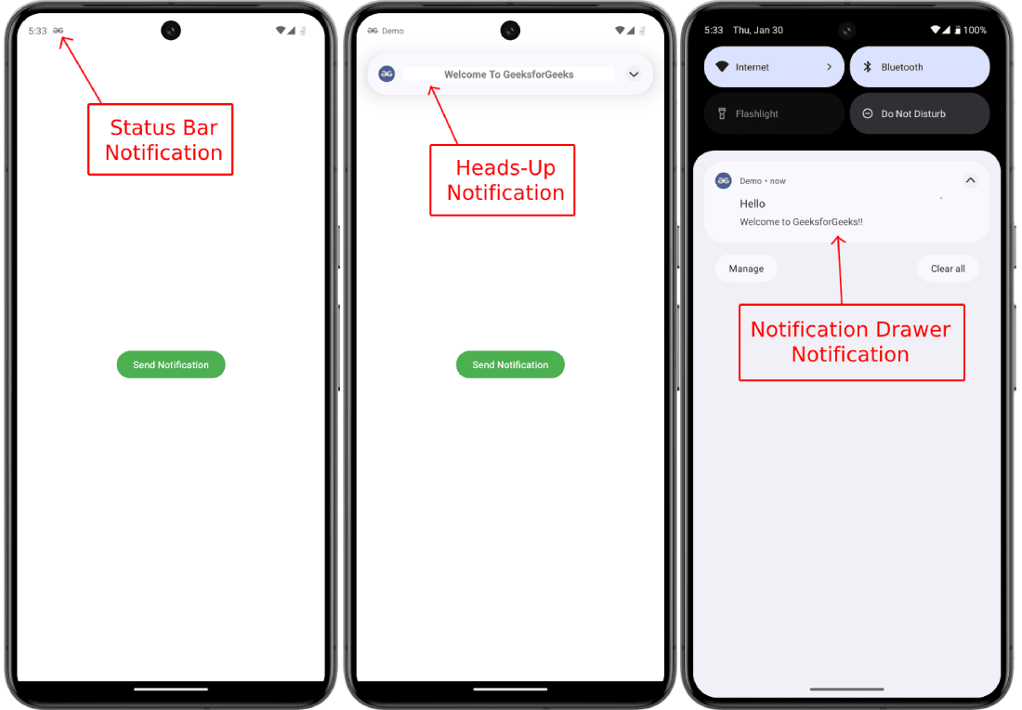

Slide 32
The properties of Android notification are set using NotificationCompat.Builder object.
setSmallIcon(): It sets the icon of notification.
setContentTitle(): It is used to set the title of notification.
setContentText(): It is used to set the text message.
setAutoCancel(): It sets the cancelable property of notification.
setPriority(): It sets the priority of notification.

Slide 33
Telephony API
The telephony system is a software framework to provide mobile phones with telephony functionalities, such as voice call, Video call, SMS,MMS ,data service, network management and so on.
To access the Telephony Manager import the android.telphony.TelephonyManager class.
Next, need to use the getSystemService() to create the TelephonyManager object, and then you can use it to get system information.
val telephonyManager = getSystemService(Context.TELEPHONY_SERVICE) as TelephonyManager

Slide 34
Architecture of Android Telephony
Communication Processor
Radio Interface Layer (RIL)
Framework Services
Application

Slide 35
Communication Processor
The communication processor in an Android device is responsible for handling communication tasks and collecting data from various peripherals. It takes inputs from devices such as sensors, GPS modules, and Wi-Fi chips, processes this information, and distributes it across the communication network. This processor ensures seamless connectivity and efficient data transfer between different components, making it crucial for maintaining network performance and reliability.

Slide 36
Radio Interface Layer (RIL)
The Radio Interface Layer is an interface through which the hardware components interact with the frameworks. It’s a bridge with protocols for the Telephony services and is therefore known as protocol stack for Telephone. The RIL consist of two components that are as follows:
RIL Daemon – The RIL Daemon (rild) is a crucial background process that starts up immediately when your device powers on. It is responsible for initializing the Radio Interface Layer and reading system properties to configure telephony services.
Vendor RIL - The Vendor RIL is a library specific to each network modem and is tailored to the hardware capabilities and protocols of the device’s modem. This library translates generic telephony requests from the Android telephony framework into specific commands that the modem can understand and execute.

Slide 37
Framework Services
Framework services consist of various packages and assists the Telephony Manager in directing all the application API requests to RIL. The framework services start immediately when the device boots up.
Application
Applications are the last layer of the Telephony architecture. The applications are used directly by the user to interact with the Telephony Services. Some of the standard applications are IMEI checker, Dialer, SIM Toolkit, Browser, etc.

Slide 38
Sending an SMS
Application Layer
Calls SmsManager.getDefault().sendTextMessage("+1234567890", null, "Hello", null, null);
Android Framework Layer
The SmsManager class prepares the message.
The message is passed to RIL.
Radio Interface Layer (RIL)
The RIL daemon sends the SMS request to the modem.
Hardware Layer (Modem/Baseband)
The modem transmits the SMS to the nearest cell tower.
The message is delivered through the mobile network.

Slide 39
Google API
Google provides a vast array of APIs for Android development, covering services like authentication, maps, machine learning, cloud services, and more.

Slide 40
Google Play Services | Google Maps API | Embed interactive maps.
 | Google Sign-In API | Authenticate users via Google accounts.
 | Google Location Services API | Access user location with high accuracy.
 | Google Drive API | Store and retrieve files from Google Drive.
 | Google Fit API | Access fitness data (steps, heart rate, etc.).
 | Google Cast API | Stream content to Chromecast devices.
 | Google Pay API | Enable payments through Google Pay.
 | Google Nearby API | Connect nearby devices.
 | Google Play In-App Billing API | Handle in-app purchases and subscriptions.
 | Google Play Game Services API | Integrate leaderboards, achievements, and cloud save.
AI & Machine Learning | TensorFlow Lite | Deploy machine learning models on mobile devices.
 | ML Kit for Firebase | Pre-built machine learning models.
 | Google Lens API | Recognize objects, text, and landmarks in images.
 | Google Assistant API | Integrate voice-based interactions into apps.

